Slide 1
SPECIAL USE PERMIT CASE NUMBER WSUP19-0016
Boneyard Flat Grading
Washoe County Board of Adjustment
October 3, 2019

Slide 2
Request
Excavation of approximately 500,000 cubic yards of earthen material from the Boneyard Flat area to be used as fill material throughout the Eagle Canyon residential area and the Spanish Springs Business Part industrial area.
The project is also intended to increase the holding capacity of the Boneyard Flat flood pool.

Slide 3
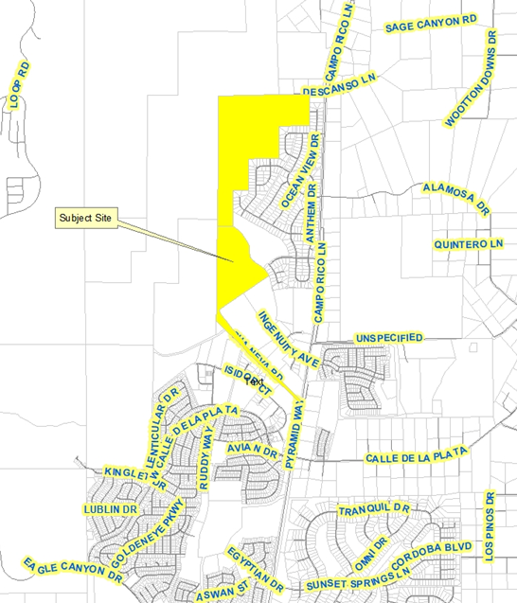
Vicinity Map

Slide 4
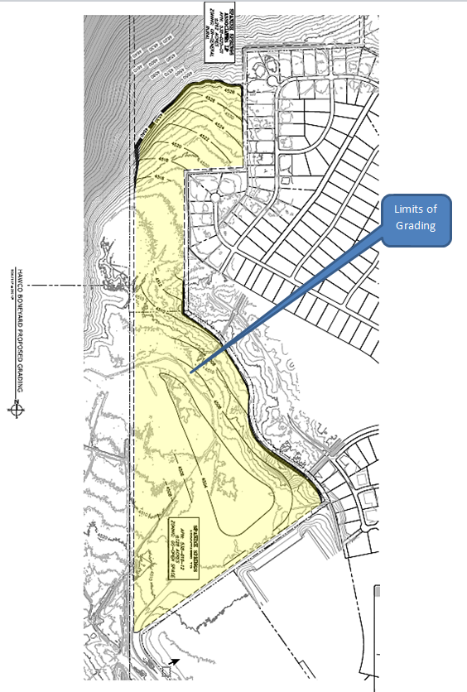
Grading Plan

Slide 5
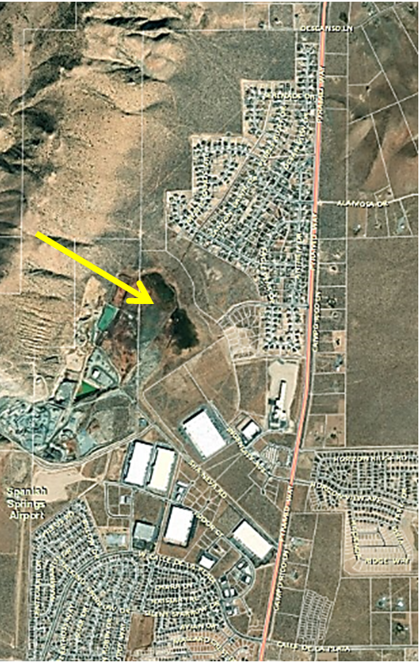
Over Head Photo

Slide 6
Overview
50 – foot buffer adjacent to property lines
4:1 slopes recommended
Final grading will mimic natural contour
Compliance with generally applicable codes
Increase stormwater capacity

Slide 7
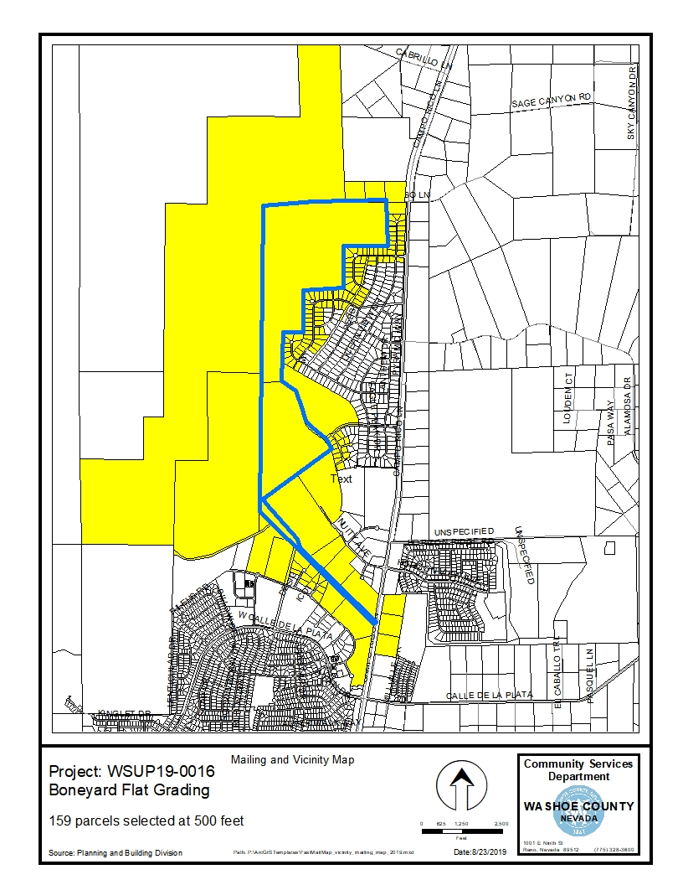
Public Notice & CAB
Notice sent to 159 affected property owners
Spanish Springs CAB reviewed the application on September 4, 2019:
Recommended approval:
  Flood mitigation a benefit
  No grading on higher slopes

Slide 8
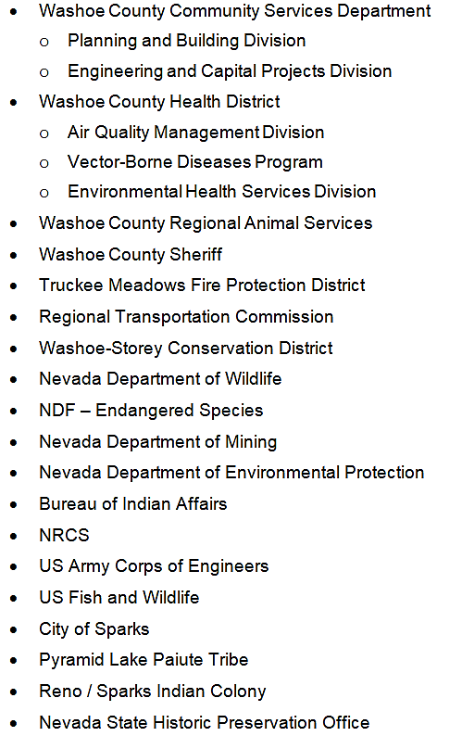
Reviewing Agencies
No recommendations for denial were received.

Slide 9
Revised Condition 1C
1c. The applicant shall submit complete construction plans with all information necessary for comprehensive review by Washoe County, and initial building permits shall be issued within two years from the date of approval by Washoe County. The applicant shall complete grading within the time specified by the building permits. Compliance with this condition shall be determined by the Planning and Building Division.

Slide 10
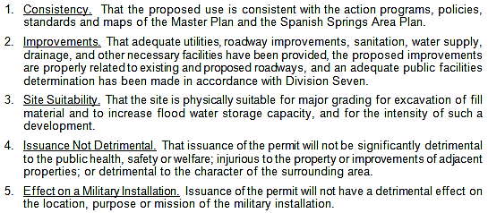
Special Use Permit Findings
Staff comments on findings are on page 8 of the staff report.

Slide 11
Recommendation
Those agencies which reviewed the application recommended conditions in support of approval of the project. Therefore, after a thorough analysis and review, Special Use Permit Case Number WSUP19-0016 is being recommended for approval with conditions.

Slide 12
Possible Motion
I move that, after giving reasoned consideration to the information contained in the staff report and information received during the public hearing, the Washoe County Board of Adjustment approve with conditions Special Use Permit Case Number WSUP19-0016 for Spanish Springs Associates, LP, having made all five findings in accordance with Washoe County Code Section 110.810.30

